Slide 1

GROUP 7
AIR QUALITY MONITORING WITH ARDUINO ESP8266

Slide 2


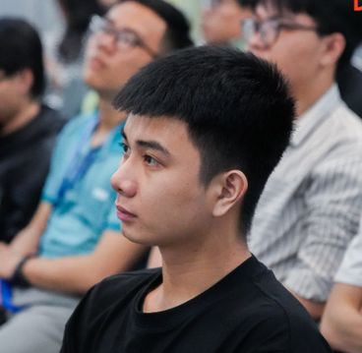

MEMBERS
Mr. Dai Trinh Vinh
Mr. Vu Le Huynh Quang
21521915
21522797

Slide 3
TABLE OF CONTENTS
1
2
3
4
OBJECTIVE
SETUP
NETWORK DIAGRAM
RESULT
Project purposes.
Hardware.
Software.
Visualization.
Demo.
Network flow.
System design.

Slide 4




1.Objective
Examine
Awareness
Solution

Slide 5
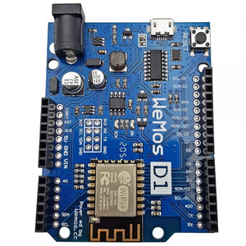
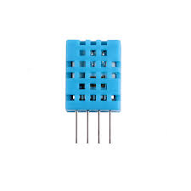



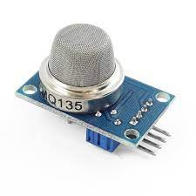
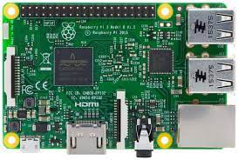

2.SETUP
Hardware
Software
Wemos D1 R2
DHT 11
Arduino IDE
Blynk
MQ135
Raspberry Pi 3
AWS
LAMP Server

Slide 6
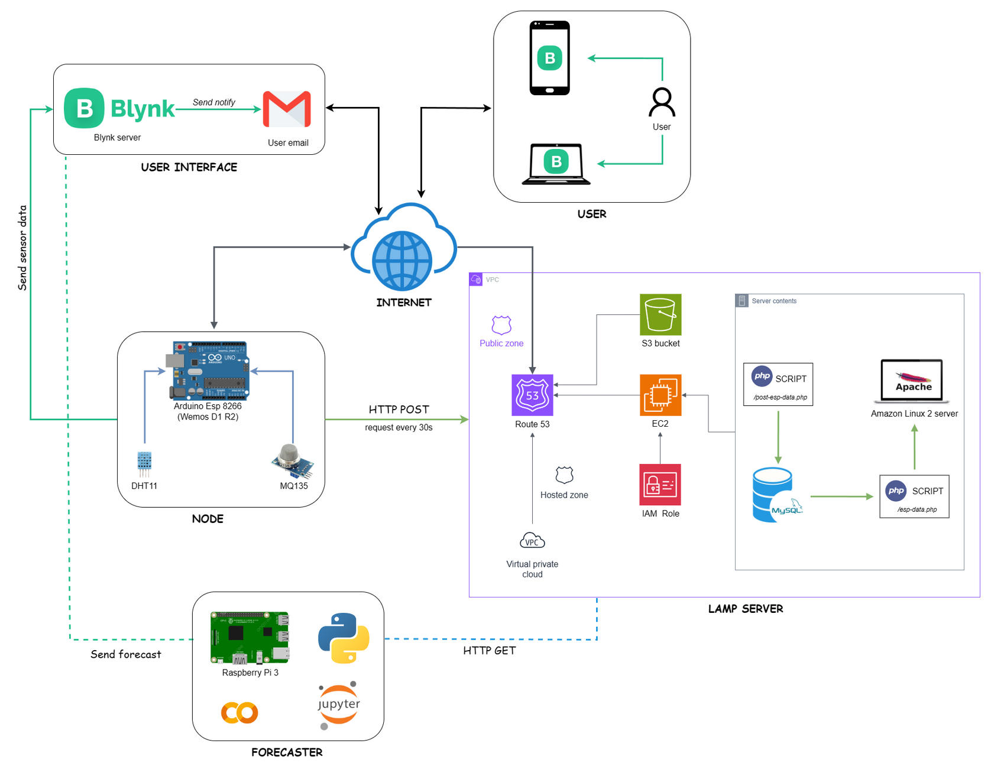
3.NETWORK DIAGRAM

Slide 7
Notes:
Remember to combine user and user interface here, people get confuse about how user interact with user interface.

Slide 8
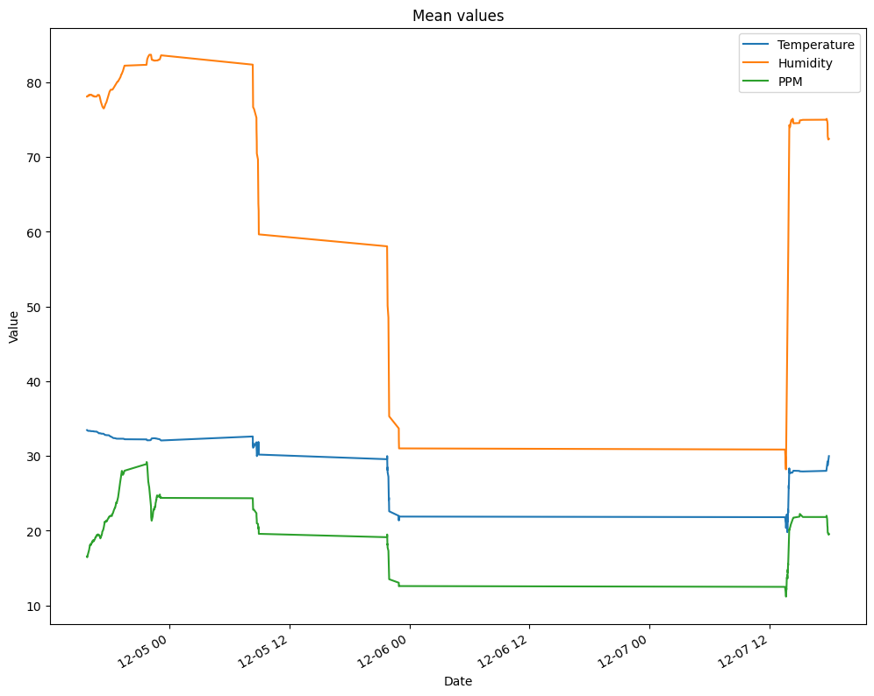
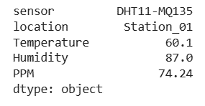
4.RESULT

Slide 9
DEMO

Slide 10

THANK FOR WATCHING!

